Slide 1
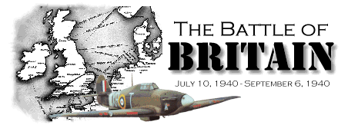
Agent Based Modeling for Military Applications CSS 739 - 005
To big wing, or not to big wing, now an answer
Presented by: Matthew Oldham

Slide 2
Agenda
The Battle of Britain
Lanchester’s Laws
Review of previous attempts to answer the question
My attempt at an ABM
Questions

Slide 3
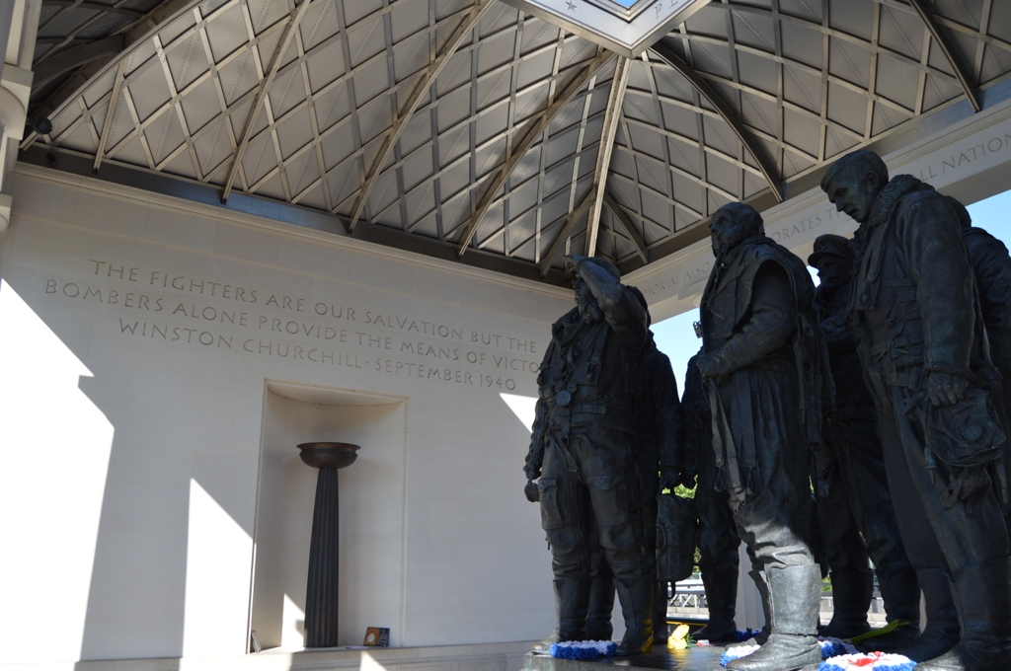

Slide 4
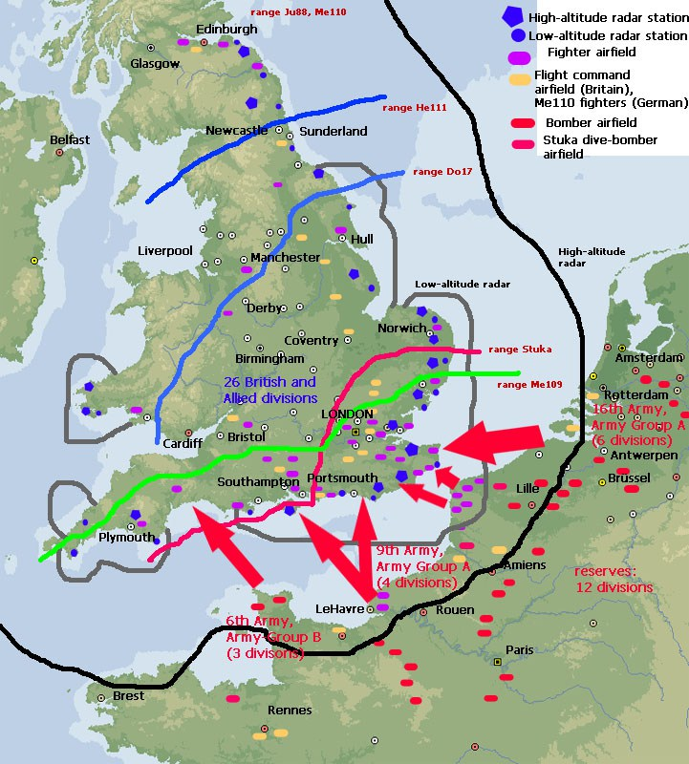
Two phases
Destroy Fighter Command
Bomb Britain into submission
Only 50 Km or less across the channel
Luftwaffe fighters struggled with range
Source: http://ww2-weapons.com/battle-of-britain/

Slide 5
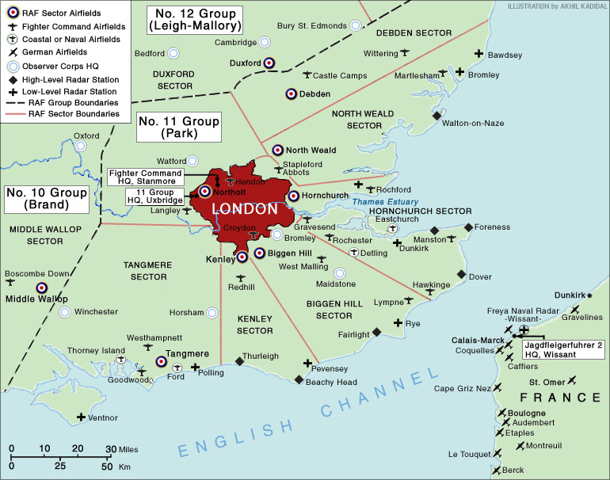
The British Defense Strategy
Britain divided into various sectors/ groups
Strategy around Lanchester model
11 Group bore the brunt of the action
12 held in reserve

Slide 6
Big Wing
Different tactics for 11 and 12 Group
Originally 11 attacked in single or 2 squadrons (12 planes per squadron)
12 Group preferred to mass up in a wing of up to 5 squadrons (60 aircraft)
Contrast of short sharp engagement vs massed attack
Penalty was time to form up the wing

Slide 7
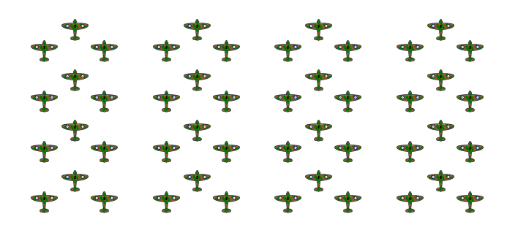
The Big Wing
http://www.classicwarbirds.co.uk/articles/typical-royal-air-force-squadron-and-tactics-during-the-battle-of-britain.php

Slide 8
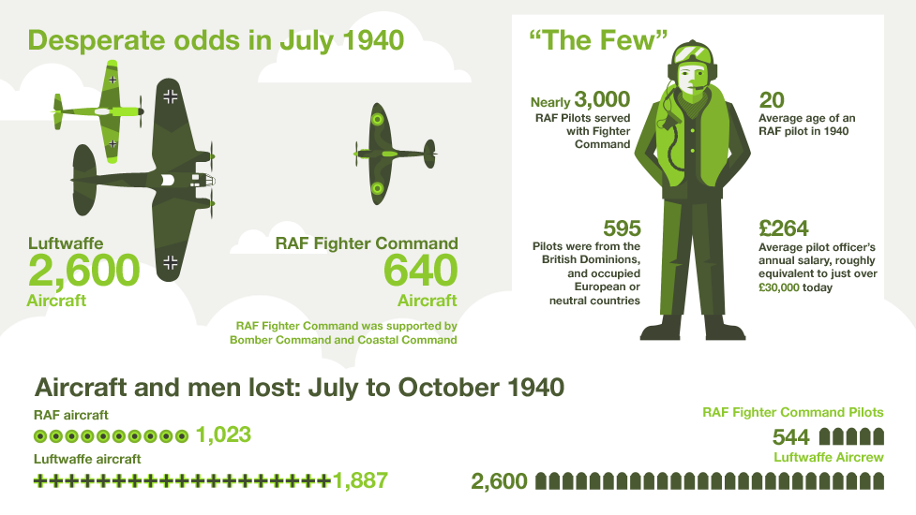
The Cost of the Battle
BBC
source:http://www.bbc.co.uk/guides/zgs34j6

Slide 9
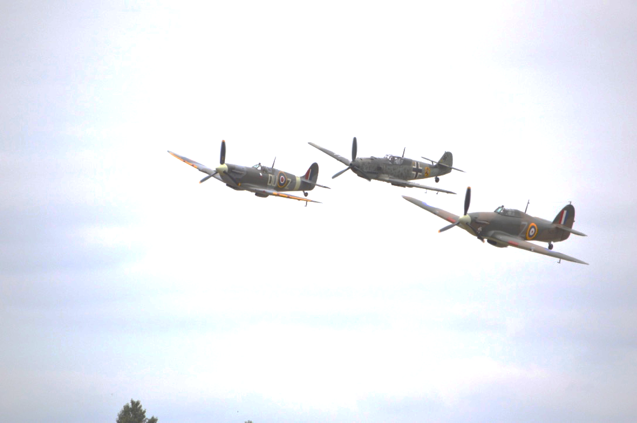
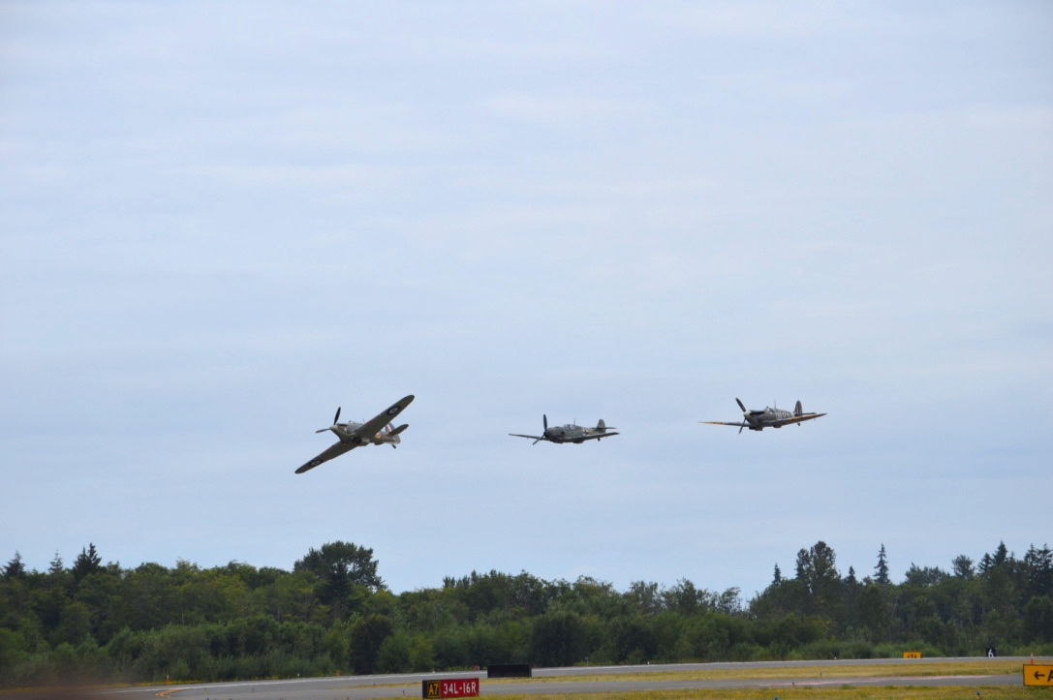

Slide 10
Sortie Combinations
Graphs reproduced from Johnson, I. R., & MacKay, N. J. (2011)
Despite the numerical disadvantage the RAF out sortied the Luftwaffe.
Sortie did not equal combat though

Slide 11
Loss Rate Via The Data
Graphs reproduced from Johnson, I. R., & MacKay, N. J. (2011)

Slide 12
Lanchester Laws (1916)
dB/dt= -gG^{g1}B^{b1},
dG/dt= -bB^{b2}G^{g2}
Aimed fire model
gG²=bB² or gG²-bB²
Allows this
Log(dB/dt)= log g+g1 log German Forces
+ b1 log British Forces

Slide 13
Literature Review
Johnson, I. R., & MacKay, N. J. (2011) and MacKay, N., & Price, C. (2011) apply Lanchester model to the Battle of Britain data
Have also analyzed battles – Pacific, Korea and more
Issue is only sorties per day
“Hand waving” to allow sorties per day as buckets
Sortie did not mean combat
Does it really answer the question of what happens in an engagement?

Slide 14
British Losses in a Lanchester Setting
Graphs reproduced from Johnson, I. R., & MacKay, N. J. (2011)
dB/dt= -gG^{1.12}B^{0.18}
This is a result somewhat consistent with Lanchester
German forces more influence

Slide 15
German Losses in a Lanchester Setting
Graphs reproduced from Johnson, I. R., & MacKay, N. J. (2011)
dG/dt= -gG^{0.86}B^{0.0}
Now inconsistent because British force has no significant impact

Slide 16
Implications
Authors took an alternate approach
Utilized the force ratio (T)
g1+ b1 vs b2 + g2 (British scaling rate vs Germany’s)
1.3 vs .86
Meant………….
That RAF did not want mass concentration
Mass attacks favored the Germans

Slide 17
An ABM of the Battle of Britain

Slide 18

The RAF Infrastructure
Rally Points
Own f_fighters
Allocates fighters to a home base
Act as AWACS
Bases
Have f_fighters allocated to them
Fighters take off and return to their home base

Slide 19
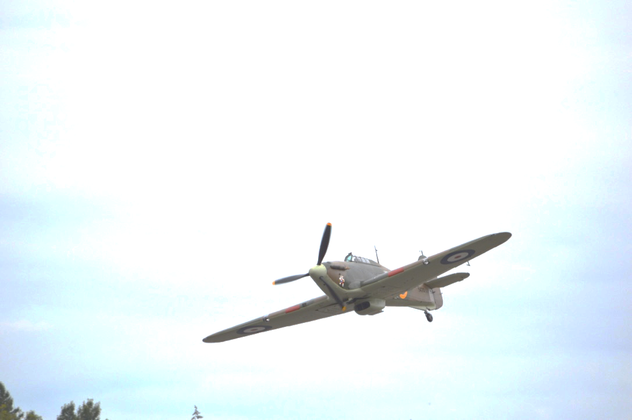
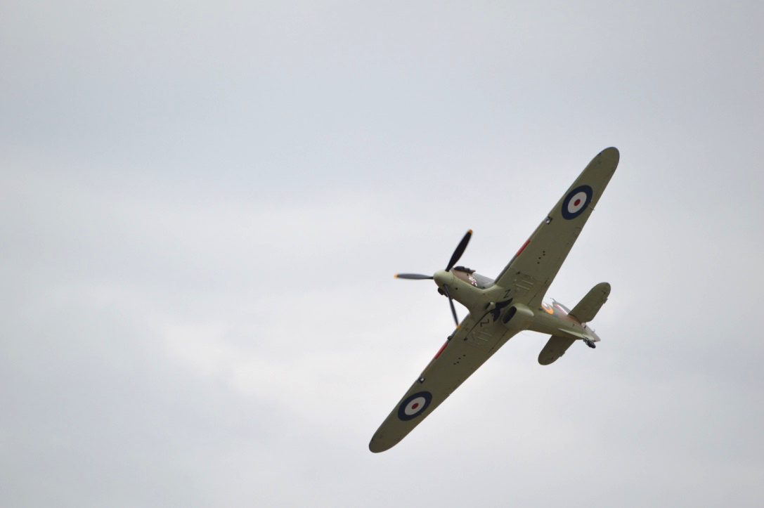
The Hurricane

Slide 20
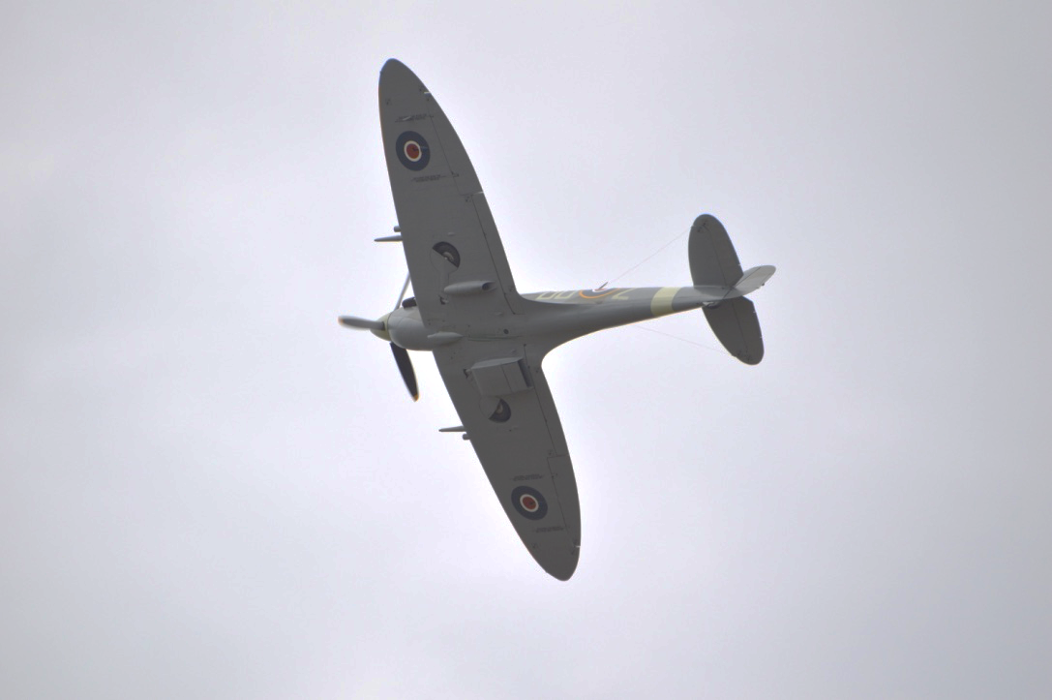
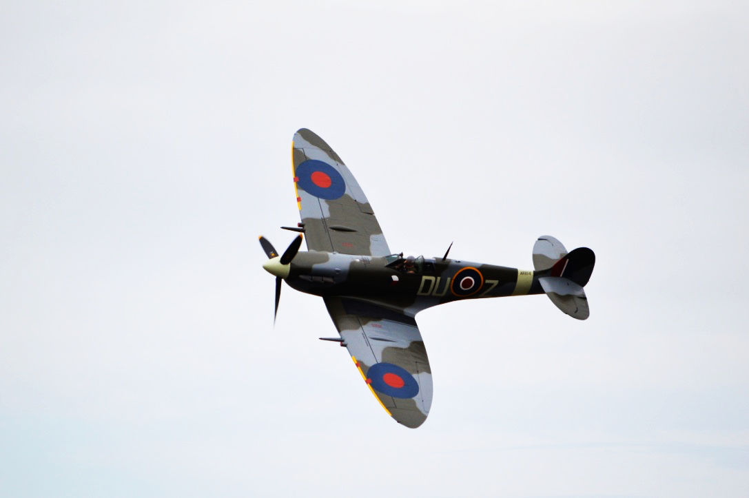
The Spitfire

Slide 21
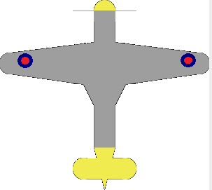
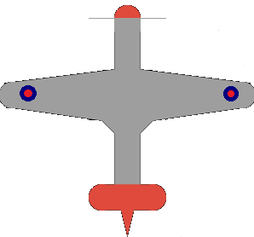
The RAF Fighters (f_fighters)
Two types
Hurricanes – chase bombers
Spitfires – chase ME109’s
Controlled by their status
scramble, formation, engaged, searching, homebound or shot down
And evading?
True or false
Other key attributes
Fuel, ammo, damage, survival, speed

Slide 22
RAF Variables
number_of_wings
Sets the number of wings the RAF scrambles
squadrons_per_wing
Sets of 12 planes that need to arrive at the rally point
number_of_home_bases
The number of bases that f_fighters are spread across
ratio_spitfires_hurr
Not used but trying to understand the influence of the fighters

Slide 23


The Luftwaffe Infrastructure
Waves
Owns e_fighters and e_bombers
Waves leave from this point and return
Allocate targets to their planes
Targets
Own co-ordinates that are given to the Luftwaffe
Rally points and RAF do not know the targets

Slide 24
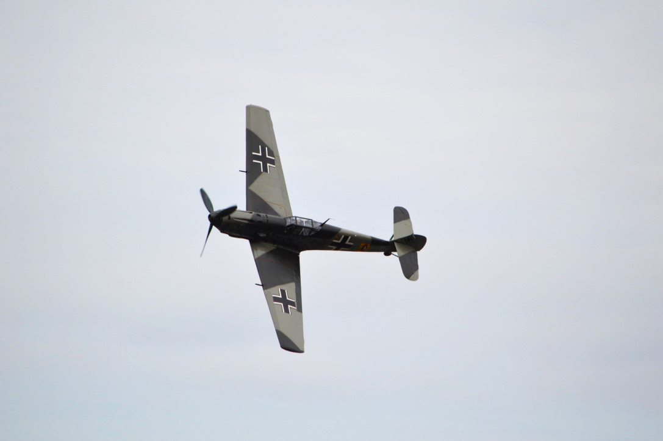
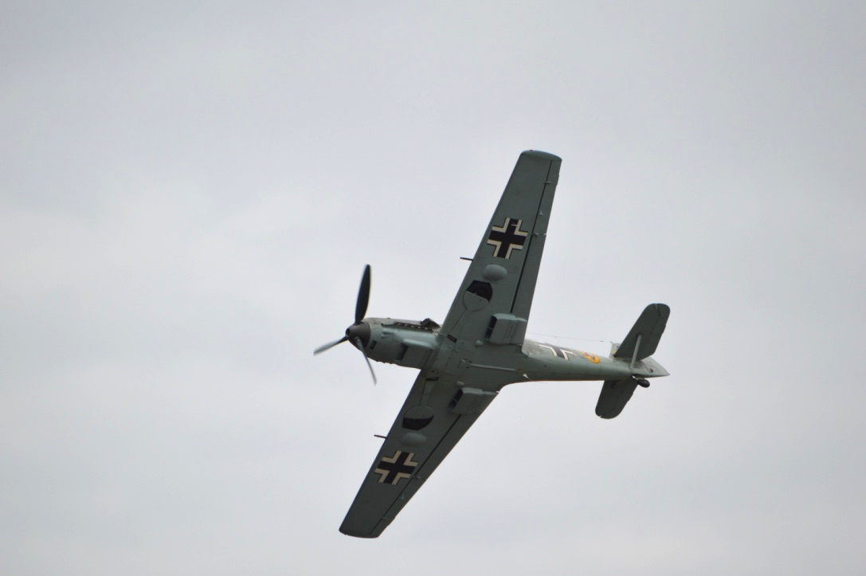
The ME109

Slide 25

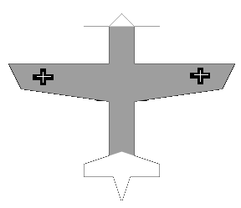
Bombers Defending
Two types
Bombers – bomb and defend
ME109’s – chase anything
Controlled by their status
formation, engaged, searching, homebound or shot down
And for the ME109’s evading?
True or false + tolerance
Other key attributes
Fuel, ammo, damage, survival, speed

Slide 26
Luftwaffe Variables
ratio_to_RAF
The size of the Luftwaffe raid compared to the RAF
ratio_fighters_bombers
The ratio of escorts vs fighters. Changed from 3-5 throughout the battle
number_of_waves
How the Luftwaffe force is split out
number_of_targets
The number of targets the raid attacks

Slide 27
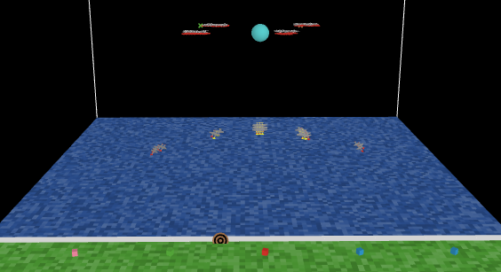
The RAF

Slide 28
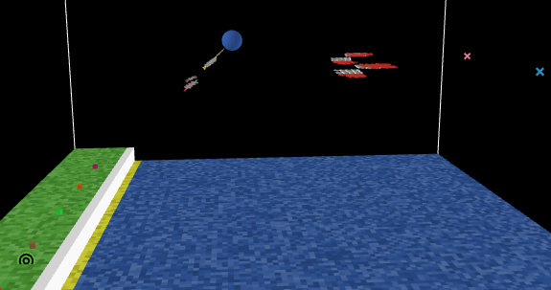
The Luftwaffe

Slide 29
The Check Procedure
Heading swings 180
Counts fighters in cone
Checks the heading of those planes
Evades if heading similar, (2) not (1)
1
2

Slide 30
The Shot Procedure
Counts planes within cone and puts them in a list
Checks the list to see if (1) or (2) is their allocated opponent
If so fires
Damage is a random float 0->.9
Shot down if cumulative damage exceeds survival
1
2

Slide 31

Bombers Defending
Bombers defend all the time
Counts the number of fighters in range – 360 degrees
Fires on any 2 of them
1
2
4
3

Slide 32
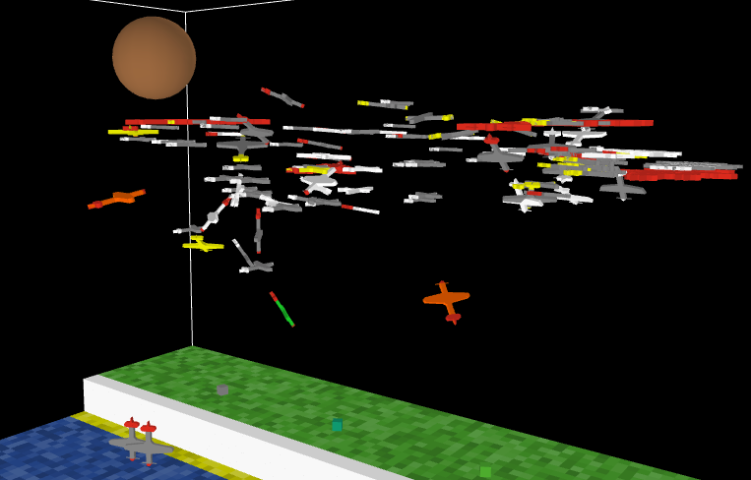
The Dogfight Part 1

Slide 33
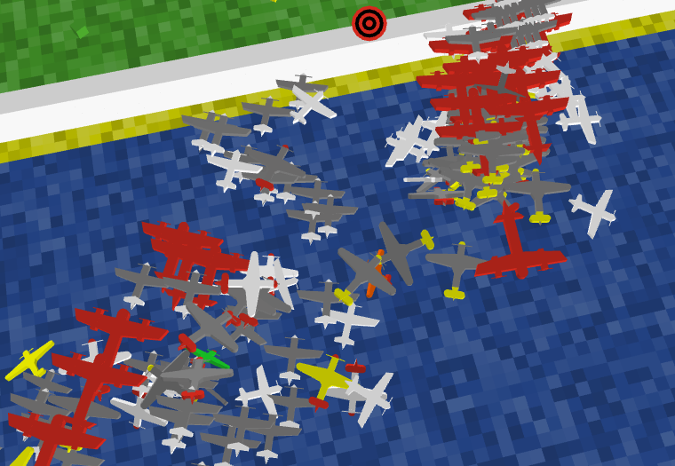
The Dogfight Part 2

Slide 34
Experiments

Slide 35
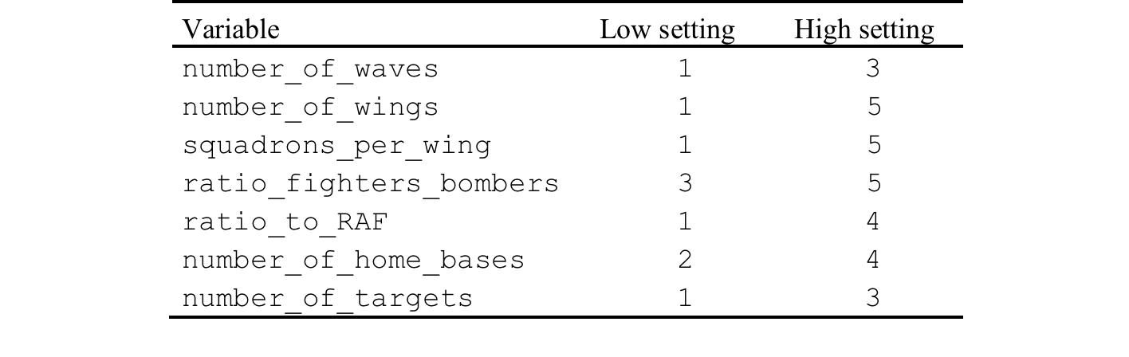
Experiments
Full factorial test
Try and understand the importance of the different inputs
Plus 1 wing 5 squadrons vs 5 wings 1 squadron.
Ratio_to_RAF 1 - 4 in increments of .1
Other fixed

Slide 36
Results

Slide 37
Full Experiment Sweep

Slide 38
Full Experiment Sweep

Slide 39
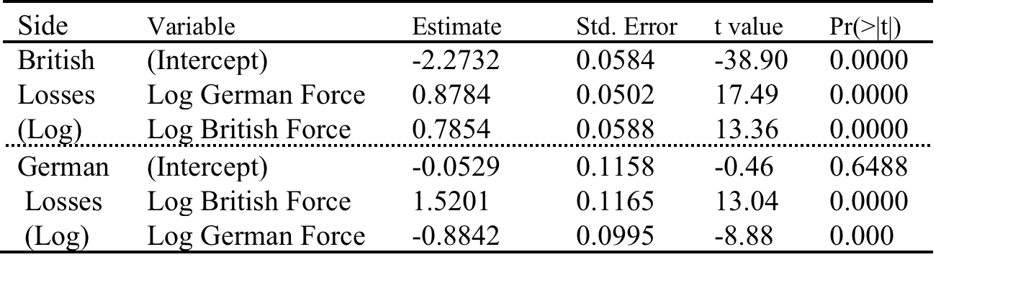
Lanchester Analysis
British losses scale at less than one for each force – acceptable under the Lanchester model
German have safety in numbers. British do get their “right whack in though”

Slide 40
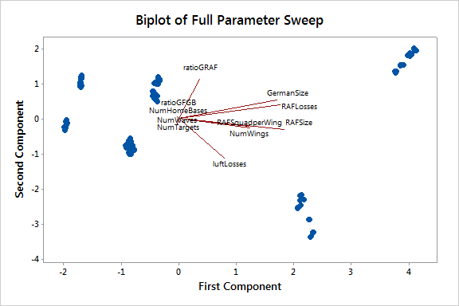
ratioGRAF = 4
ratioGRAF = 1

Slide 41
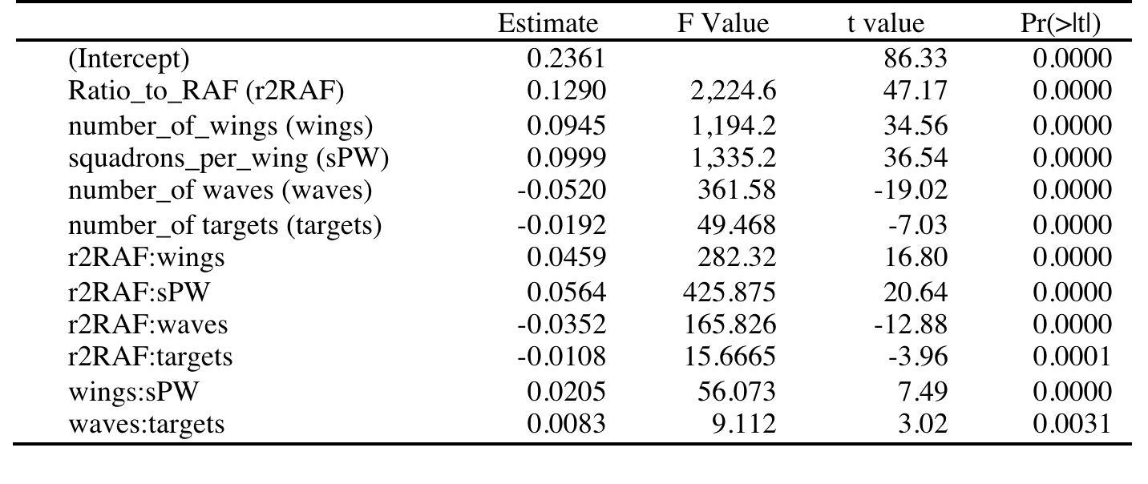
RAF loss ratio (Losses/Force Sent Up)
Look at what explains the British losses
More than just the ratio to the Germans
Interaction also plays a part
More to it than the Lanchester

Slide 42
More of the Wing Debate
Average Losses
1W 23.2%
5W 24.8%

Slide 43
Impact on the Germans
Average Losses (not s.s.)
1W 9.2%
5W 8.0%

Slide 44
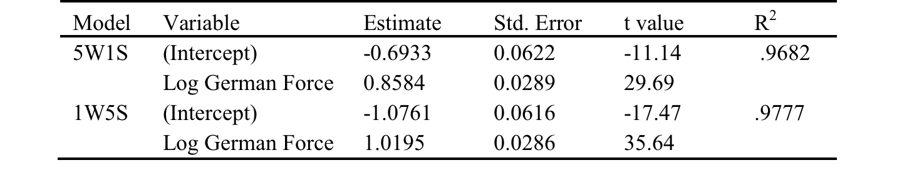
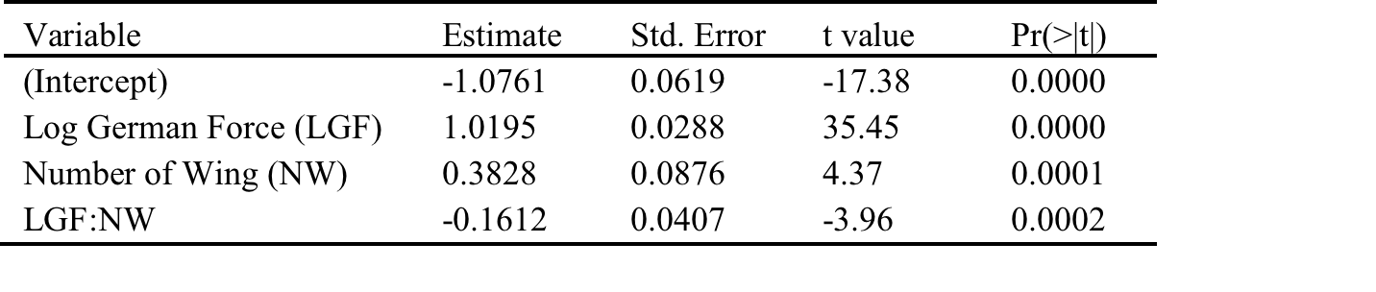
To prove the case
5 Wings – better variable cost but higher fixed cost in the battle
Maybe time in the battle is higher?

Slide 45
Questions?

Slide 46
References
Johnson, I. R., & MacKay, N. J. (2011). Lanchester models and the battle of Britain. Naval Research Logistics (NRL), 58(3), 210–222.
Lanchester, F. W. (1916). Aircraft in warfare: The dawn of the fourth arm. Constable limited.
MacKay, N., & Price, C. (2011). Safety in numbers: Ideas of concentration in Royal Air Force Fighter Defence from Lanchester to the battle of Britain. History, 96(323), 304–325.

